Slide 1

Water Quality Monitoring System
This project aims to develop a Complaint Management System to streamline the process of handling citizen grievances for a city administration. Through a user-friendly web application interface, citizens can submit complaints regarding issues such as water leakage and contamination.
By- Priyanshu Kumar Rawat
Anudip ID- AF0444396

Slide 2



Project Scope
Objective
Problem
Solution
To develop a platform for reporting water quality complaints.
Poor water quality impacts health and environment. A real-time monitoring system is needed.
Collect, store, and analyze water complaint data. Enables efficient decision-making and reporting.
To implement a system to manage and visualize submissions.

Slide 3
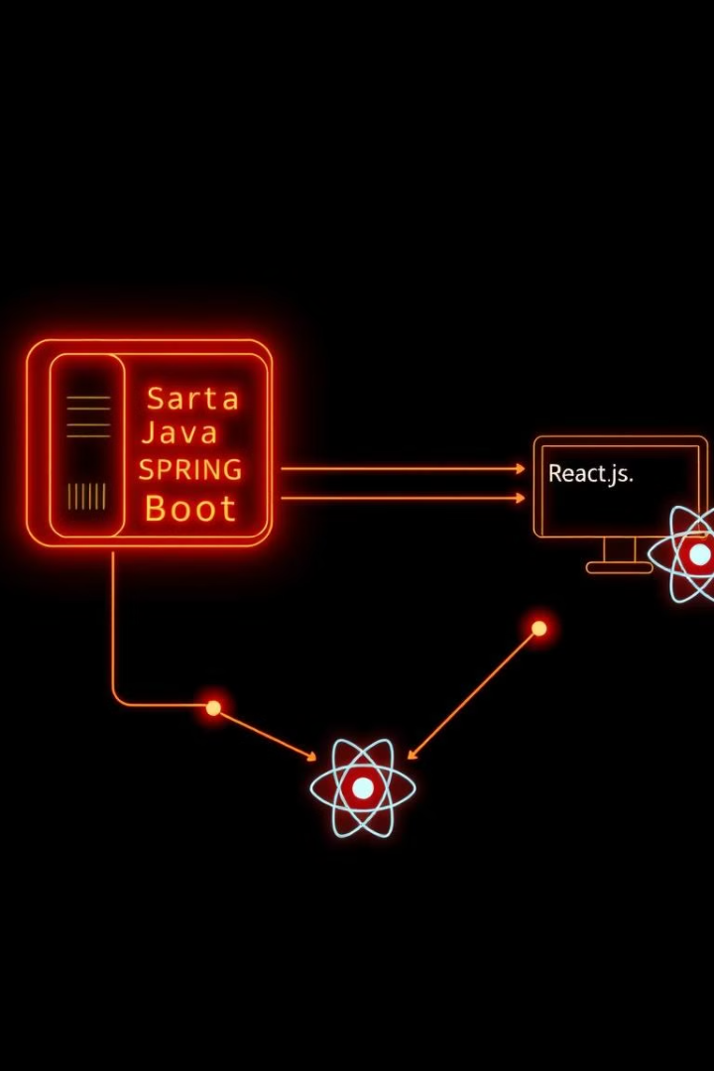




Technology Stack
Java
MySQL
React.js
(Spring Boot, Maven)
Tools
VS Code, GitHub, Postman
Built using a robust and modern technology stack to ensure scalability and reliability.

Slide 4
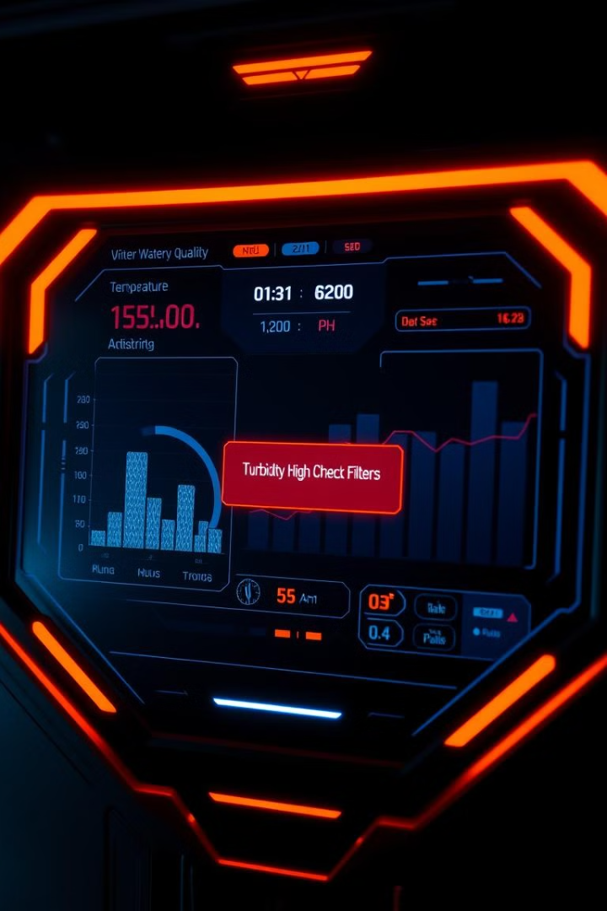
Project Features & Modules
User & Admin Modules: Users can report water issues, and administrators can review and take action.
Complaint Management: Users can file complaints about contaminated water, and authorities can track resolutions.
Public Awareness & Reporting: Allow users to raise complaints if water contamination is detected.
Spring Boot Backend & React Frontend: Ensures a scalable and responsive system for efficient data handling.

Slide 5



ER Diagram
Relationships:
User (User submitting complaints)
One User can submit multiple complaints
(1:N relationship).
One Admin can manage multiple complaints
(1:N relationship).
Complaint (Complaint details)
Each Complaint has a defined status
(Pending, Resolved,
or Rejected).
Admin (Handles complaints)

Slide 6
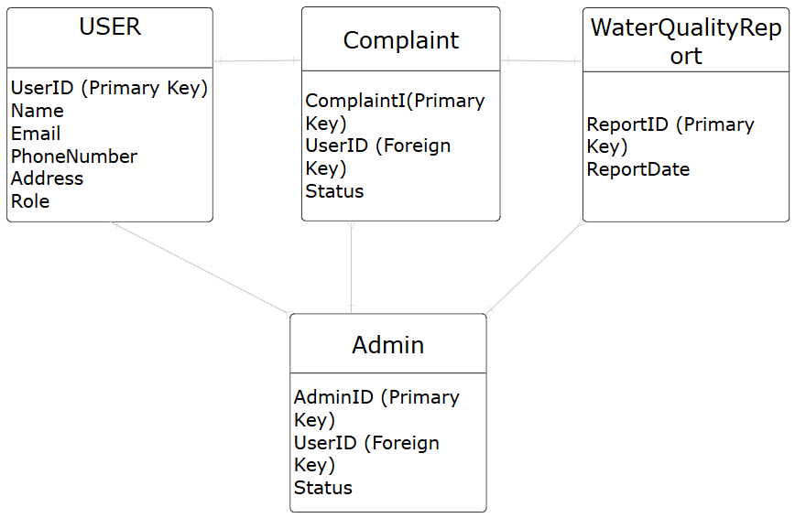

Slide 7
Future Enhancements & Conclusion
AI Integration
1
Predictive water quality analysis.
Mobile App
2
Real-time monitoring on-the-go.
Sensor Support
3
Expand to multiple sensor types.
Scalable system for water quality monitoring. Provides real-time insights.

Slide 8
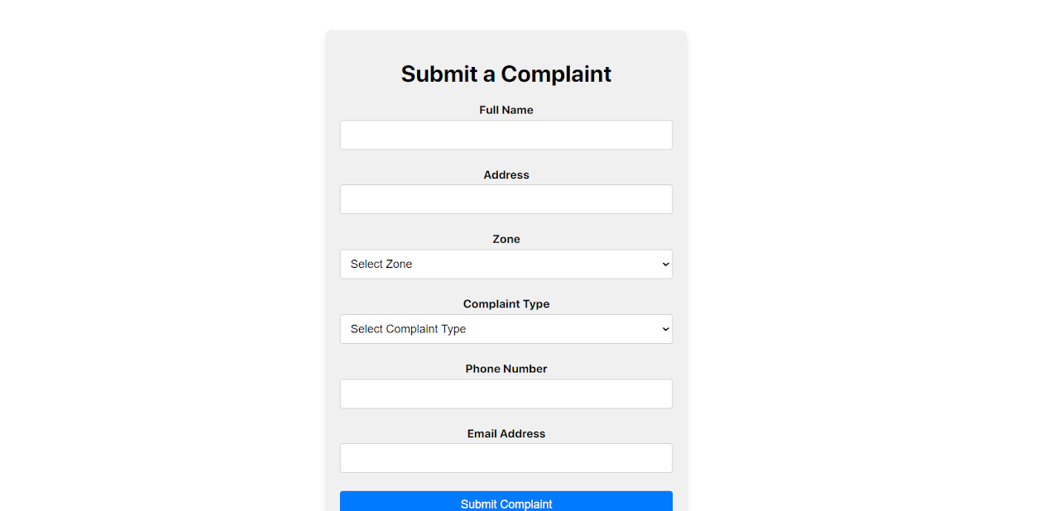
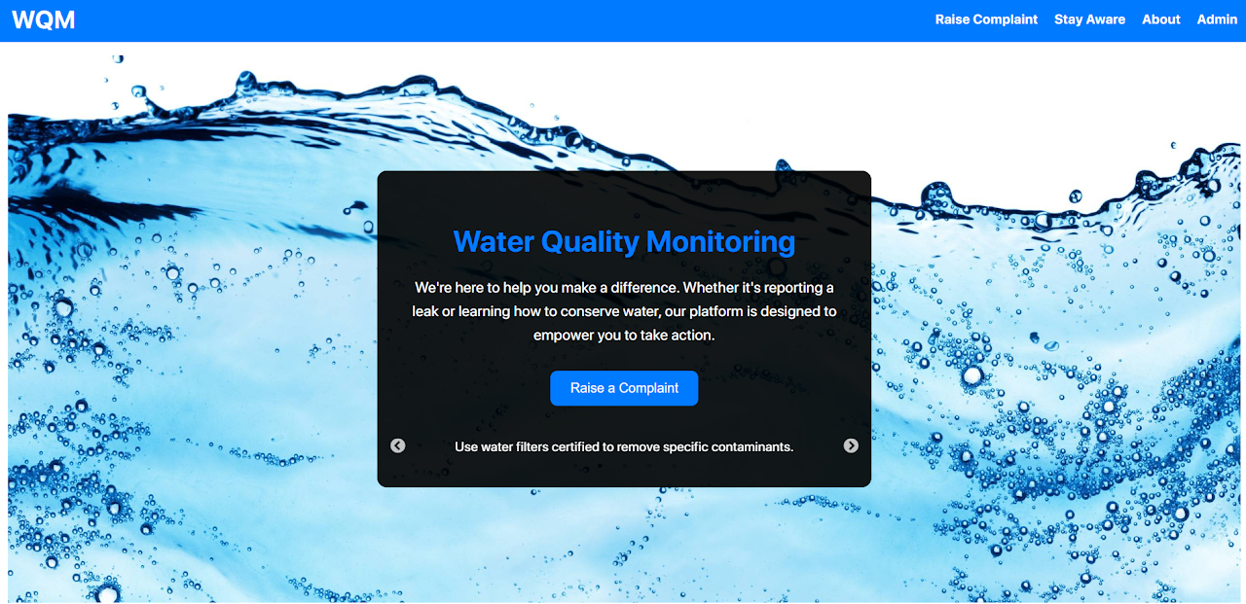
Implementation & Execution
For Front-End -> npm start
For Backend -> mvn spring-boot:run

